Slide 1







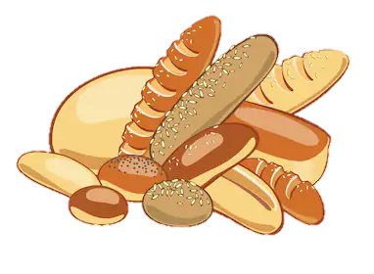

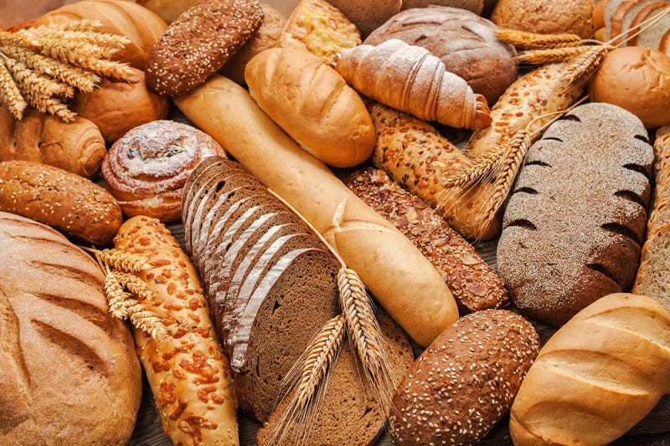
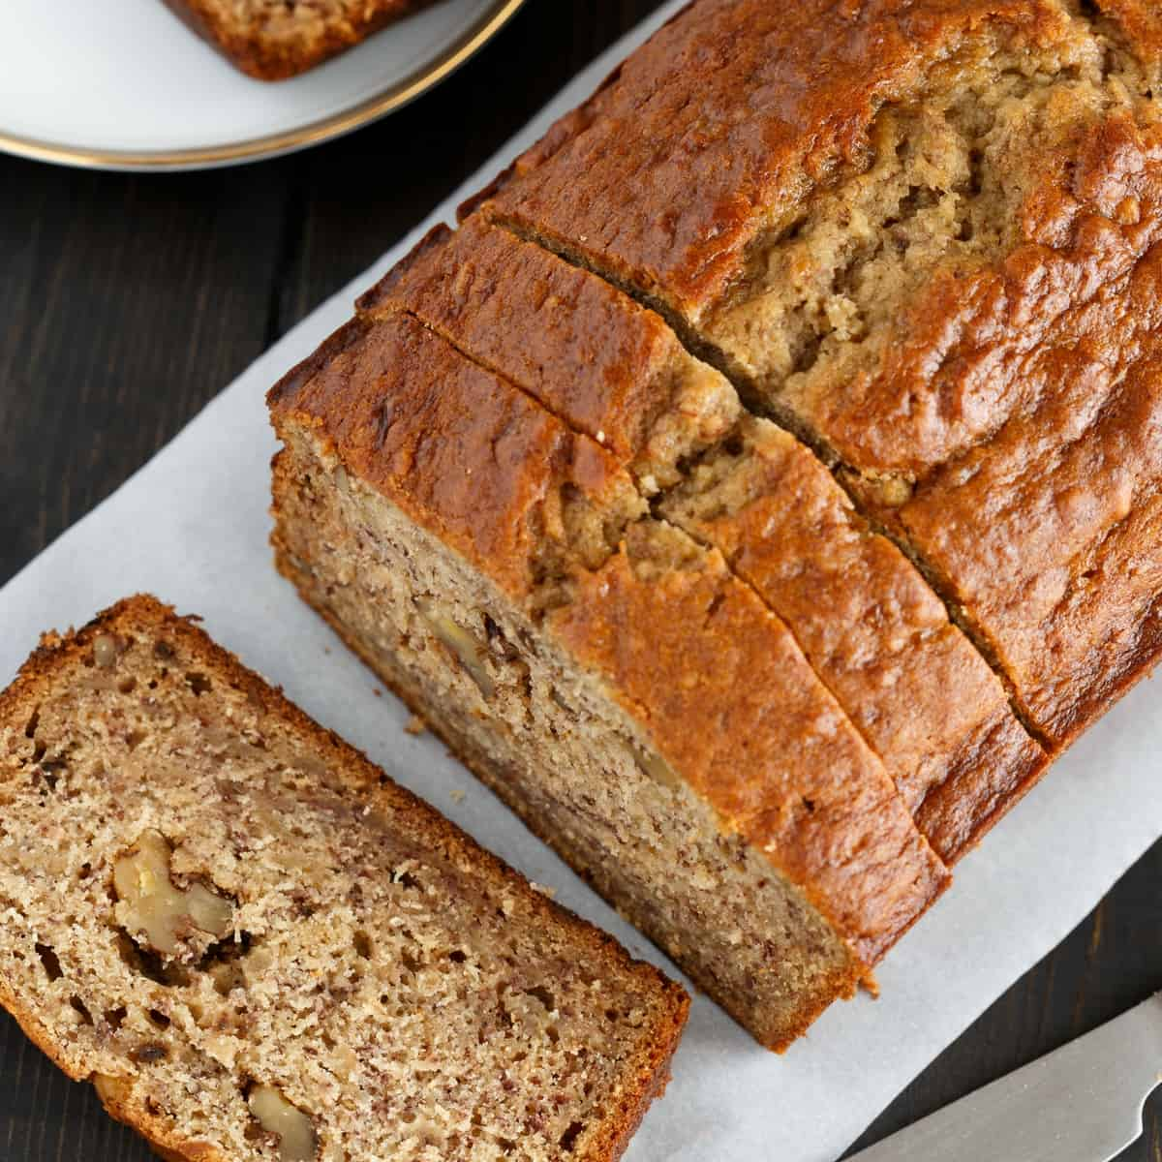
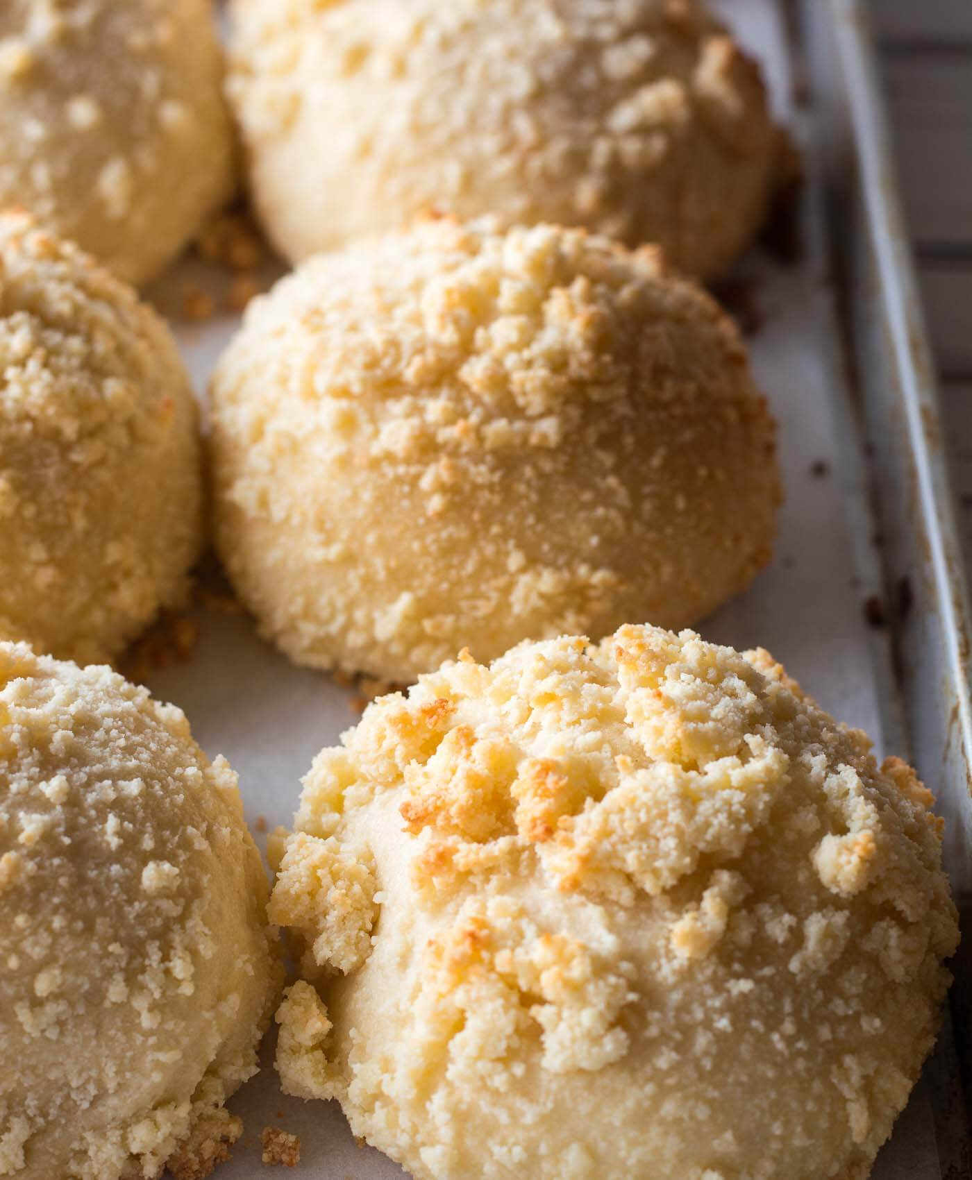
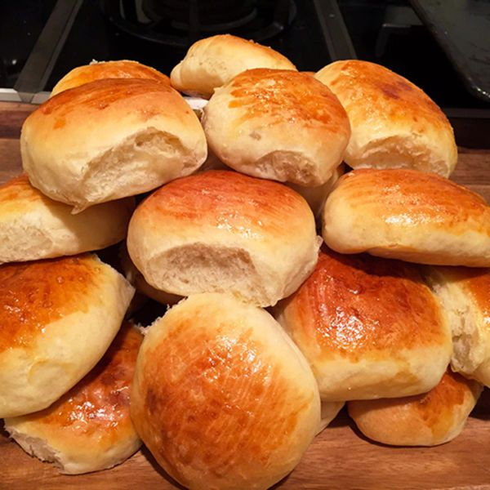
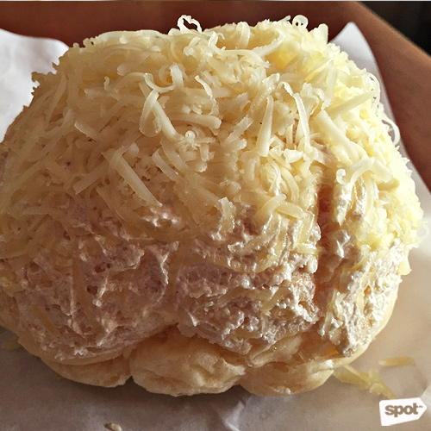
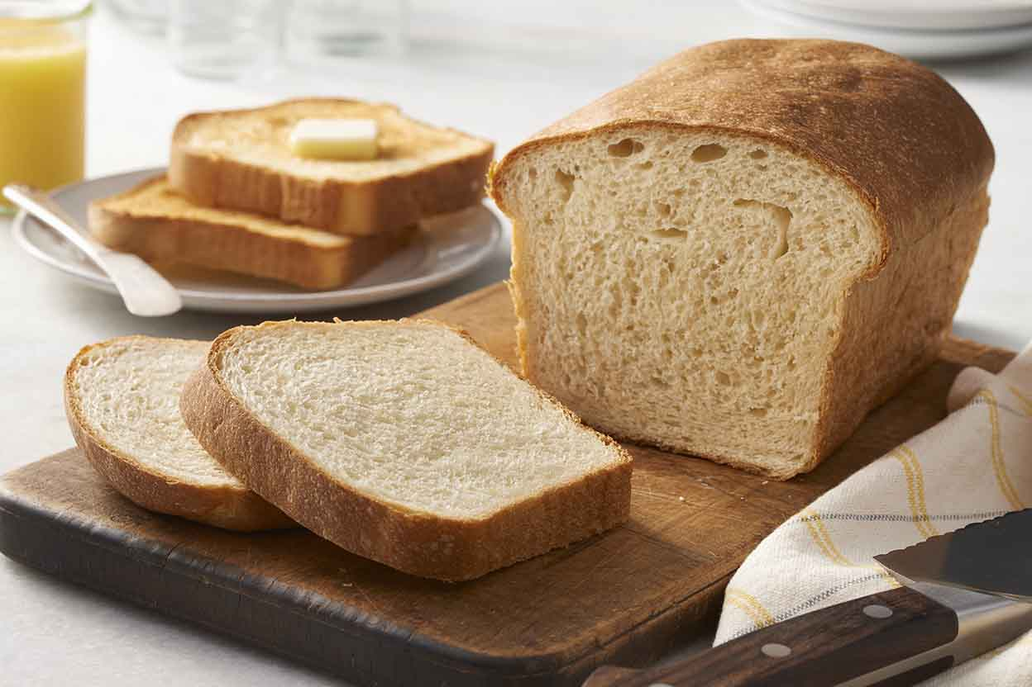
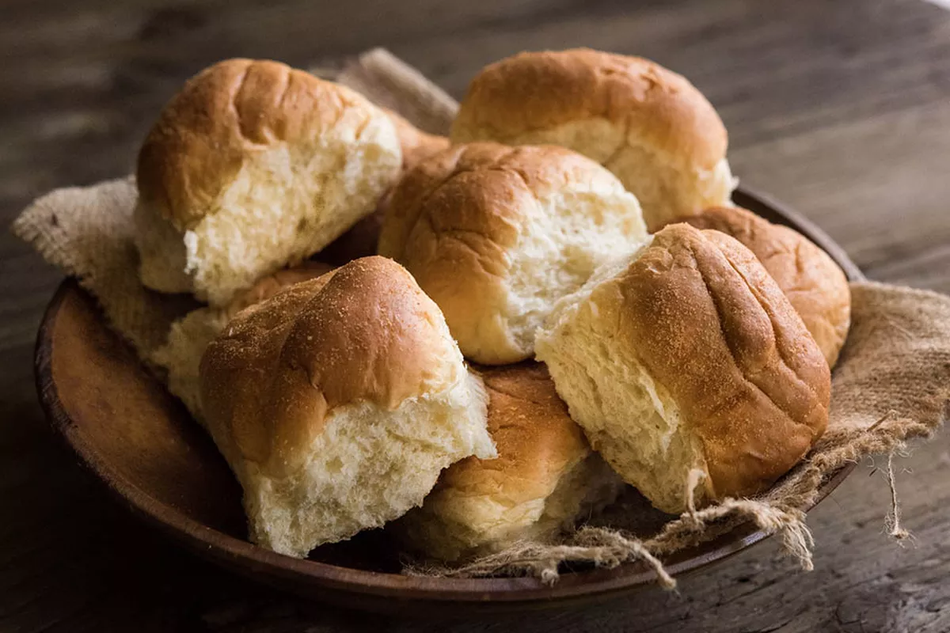
HOME
MENU
ABOUT
SHOP
RECIPE
PRODUCTS
SEARCH
HAPPINESS
SMELLING BREAD
Banana Loaf
Cheese Bread
Pan de Coco
Ensaymada

Slide 2


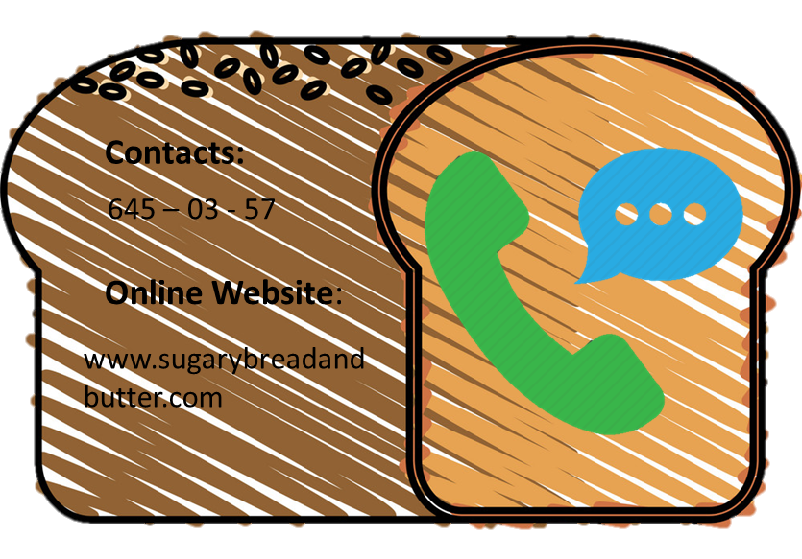





Email us:
sugarybreadandbutterbakery@gmail.com
Banana Loaf
Bread made from mashed, ripe bananas, butter, sugar, egg, vanilla, baking soda, and flour.. It is often a moist, sweet, cake-like quick bread.
P95.00
Ensaymada
A Filipino sweet bread, is one of the many pastries derived from Spanish origins. Originaly sweet bread is one large snail-like coil dusted in sugar.
P25.00

